Slide 1
HYBRID CLOUD SERVICE
Sprint 2 demo : Feb 23, 2016
-Akash Singh
-Jaison Babu
-Surekha Jadhwani
-Vignesh Shanmuganathan
Mentor: Xu(Simon) Chen

Slide 2
Sprint 2 : Feb 23
User story covered:
As a user , one must be able to store his sensitive data in a private cloud service and non-sensitive data in a public cloud service.
Migrate to twitter4j 4.0 or above for language based filtering
Install Hadoop on MOC and Spark in AWS in multi-node cluster mode
Configure spark streaming job in private cloud that consumes twitter live feed on AWS cluster
Establish communication between AWS and MOC clusters
Extend the parser algorithm that partitions the consumed data into private and public based on twitter tags
Setup and run twitter parser in AWS

Slide 3
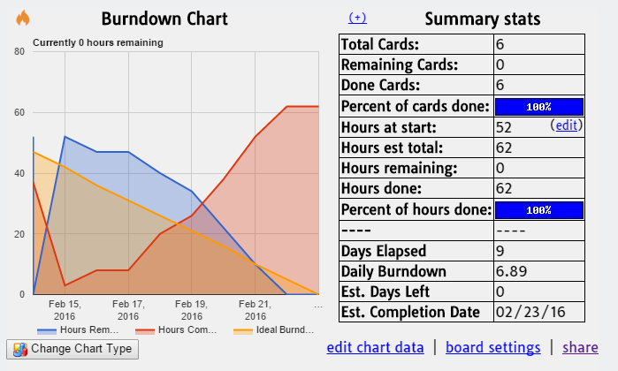
Trello Burndown:

Slide 4
Problems Faced:
AWS EC2 script by default creates m1-large instances:
M1-large instance is expensive, and the script failed for t2-micro instance with security concerns. So manually had to setup the complete spark cluster.
Saving twitter data feed into JSON format :
Explored the various data formats options to store twitter feeds.
Tried using GSON library and spark streaming library.
Configuring Spark cluster on MOC:
Unable to assign free port to Spark( Error initializing SparkContext. java.net.BindException: Can't assign requested address).

Slide 5
Plan for Sprint 3: Mar 15
User story planned:
As a user , one must be able to run spark analytical job on Spark Hadoop AWS cluster
Generate data set having one week’s feeds for analysis.
Write a simple analytical job.
Run the analytical job on local machine and check for correctness.
Modify the job to support Spark cluster mode.
Run the job on AWS Spark cluster.
Run the job on MOC Spark cluster.

Slide 6
DEMO: https://youtu.be/gBjCb0qOYt4

Slide 7
Questions?

Slide 8
Thank You

